Slide 1
SEVENTH SENSE CONSULTING CAPABILITIES BRIEFING
Statement of Confidentiality: The information contained in this document may be proprietary to Seventh Sense Consulting, LLC and may not be transmitted or disclosed to anyone outside of the Government or authorized representatives of Seventh Sense without Seventh Sense’s written permission. This information may not be transmitted or disclosed to third party Government support contractors unless provided appropriate Confidentiality Agreements are in place to protect Seventh Sense’s interests.
CERTIFICATIONS AND SOCIO-ECONOMIC
FACTORS
(VA) CVE Certified SDVOSB
Minority Owned

Slide 2
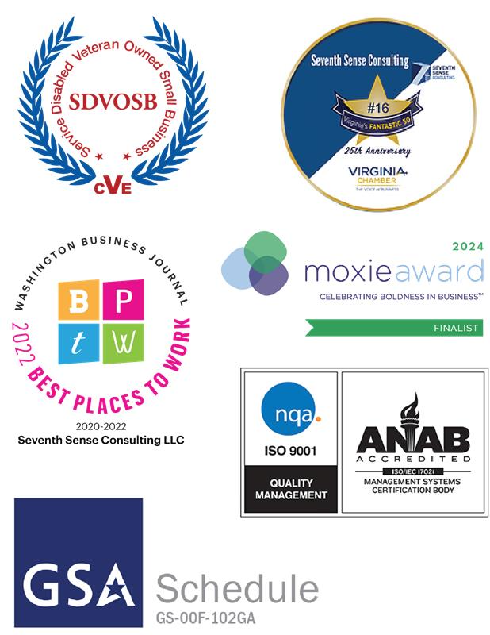
Corporate Overview
Seventh Sense Consulting (SSC) was established in 2012. SSC is a Virginia-based, Minority-Owned, VA CVE Certified Service-Disabled Veteran-Owned Small Business (SDVOSB). SSC supports Federal and Defense agencies in providing innovative solutions to everyday problems.
We specialize in MANAGEMENT, TECHNOLOGY and ACQUISITION consulting services. Additionally, we offer a suite of SOFTWARE PRODUCTS that are tailored to meet your business needs.
ISO 9001:2015 SVC Certified Company Wide
GSA – Multiple Award Schedule Contractor
GCC-High Cybersecurity Maturity Model Certification (CMMC)
SDVOSB Certified
Joint Venture Partners
Our Software Products
Enlightened Solutions Software Suite
SAM PROFILE DATA
DUNS: 078425777
Cage Code: 6Q7M4
Socio-economic: VA CVE SDVOSB Certified Company
GSA Corporate Schedule: GS-00F-102GA
CONTACT US:
CDO@SeventhSenseConsulting.com
14626 Crossfield Way
Woodbridge, VA 22191
(703) 244-6297
www.seventhsenseconsulting.com
Acquisition

Slide 3
Corporate Overview
Management
CIO Advisory & Strategic Support Services
Program/Project Management
Program Management Office (PMO)
Product Management and Delivery
Business Analysis & Requirements Management
Organizational Assessments
Customer Support/Helpdesk
Technology
Data Analytics
Software Design, Development and Maintenance
SharePoint Development and Operations
Artificial Intelligence
IT Program Management
Our Core Services
Acquisition
Acquisition Planning and Pre-award Acquisition Development
Procurement
Contract Management
Acquisition Policy, Sustainment, and Quality Assurance
Budget planning, Cost Allocation & Funding Tracking
Training
Systems Engineering and Technical Assistance (SETA)
Products
Facilitated Intelligent Needs Development (FIND) for development of procurement request packages
Contractor Performance Intelligence (CPI) for post-award contractor performance management
Spend Intelligence (SI) for spend planning and management

Slide 4
Who We Are at Our Core
INSIGHT
“Armed with highly skilled members deploying various resources to ensure work is high quality and competitive.”
INTEGRITY
“A Trusted Advisor Delivering Products and Services to Dramatically Improve Business Performance."
VISION
VALUES
MISSION
INNOVATION
“Enlightened Solutions Suite of Products and an Employee Bonus Plan that encourages innovation and quality”
We've found success in this approach since inception and because of it, we have grown 50% Year over Year. The truth is, we think outside of the box and use our seventh sense to drive enlightened solutions.

Slide 5
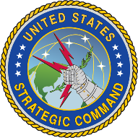
Our Clients Across the Federal Space

Slide 6
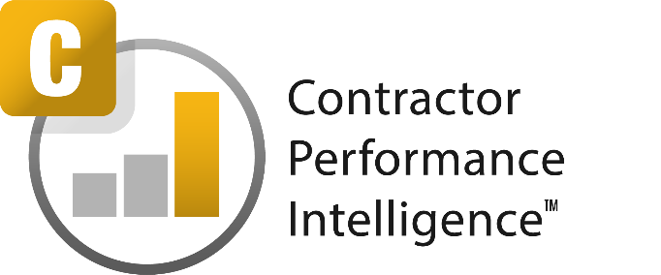
Our Enlightened Solutions Software Suite™
Software Tools for CORs and Program Managers
Enlightened Solutions™ is an "out-of-the-box", configurable suite of software products that allows acquisition professionals to efficiently plan, execute, and manage the workflow of procurement packages and contracts throughout the acquisition life-cycle. Our Enlightened Solutions suite provides intelligent support for the many PM/COR activities performed outside of traditional contract writing systems and financial management systems.

Slide 7
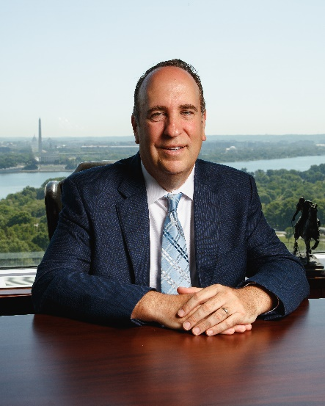
Thank you for your interest in Seventh Sense
Roger Forester
Executive Vice President of Corporate Development
foresterr@seventhsenseconsulting.com
14626 Crossfield Way
Woodbridge, VA 22191

